Slide 1
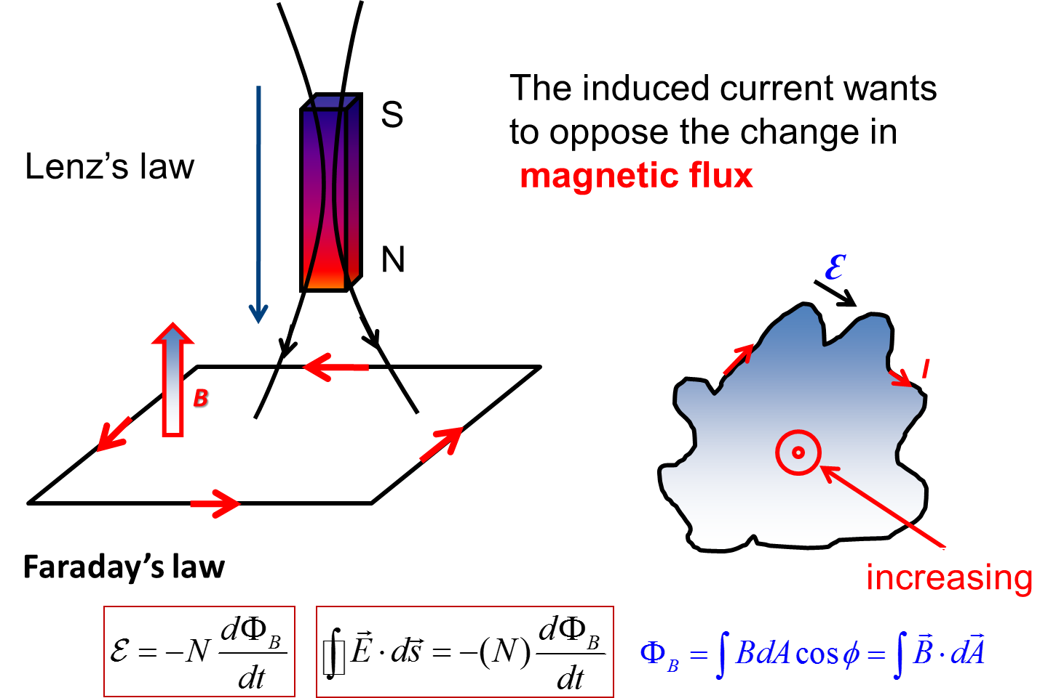
Review of Ch30 Faraday’s Law

Slide 2
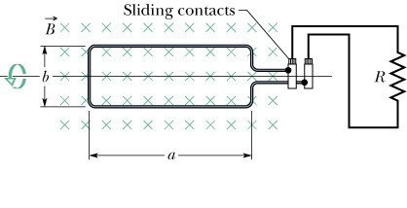
Review of Ch30 Faraday’s Law

Slide 3
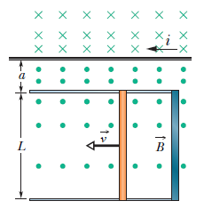
Problem 1
The figure shows a rod of length L=10.0 cm that is forced to move at constant speed v=5.00m/s along horizontal rails. The rod, rails, and connecting strip at the right form a conducting loop. The rod has resistance 0.400 ; the rest of the loop has negligible resistance. A current i=100 A through the long straight wire at distance a=10.0 mm from the loop sets up a magnetic field through the loop. Find:
the emf and current induced in the loop.
At what rate is thermal energy generated in the rod?
What is the magnitude of the force that must be applied to the rod to make it move at constant speed?
At what rate does this force do work on the rod?

Slide 4
Problem 1
(a) We consider an infinitesimal horizontal strip of length x and width dr, parallel to the wire and a distance r from it; it has area A = x dr and the flux is
According to Faraday’s law the emf induced in the loop is

Slide 5
Problem 1
By Ohm’s law, the induced current is
Since the flux is increasing, the magnetic field produced by the induced current must be into the page in the region enclosed by the rod and rails. This means the current is clockwise.
(b) Thermal energy is being generated at the rate

Slide 6
Problem 1
(c) The force of the external agent must have the same magnitude as the magnetic force and must be in the opposite direction.
The external agent must therefore apply a force of 2.87$×$10^{–8} N, to the left.
(d) The external agent does work at the rate
P = F v = (2.87$×$10^{–8} N)(5.00 m/s) = 1.44$×$10^{–7} W.
All the energy supplied by the agent is converted to thermal energy.

Slide 7
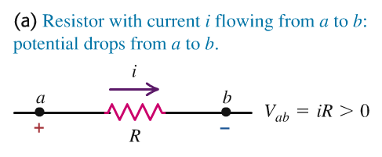
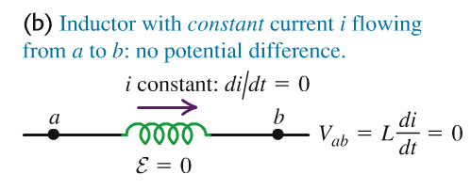
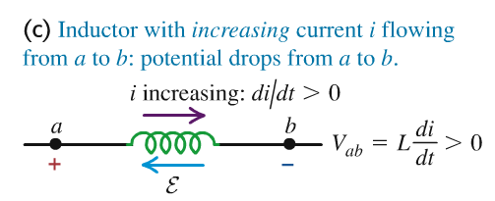
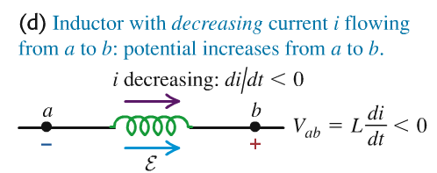
Potential difference across an inductor

Slide 8
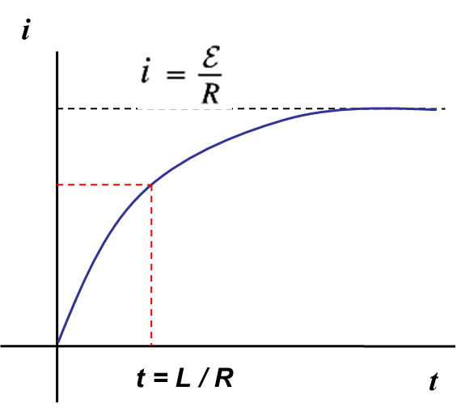
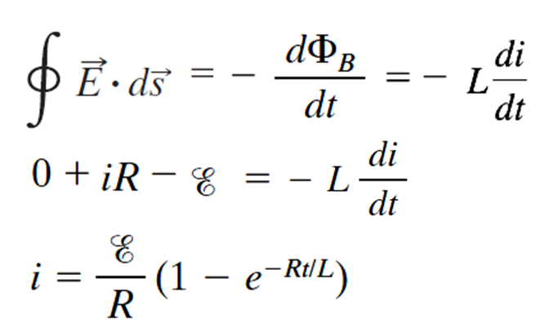
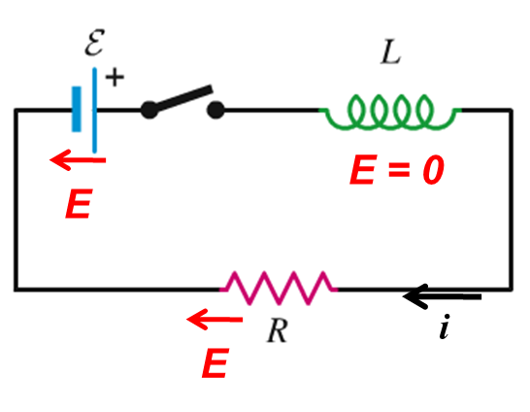
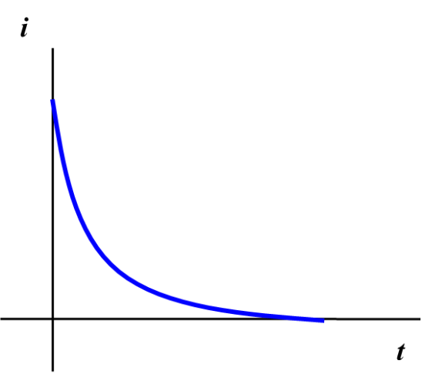

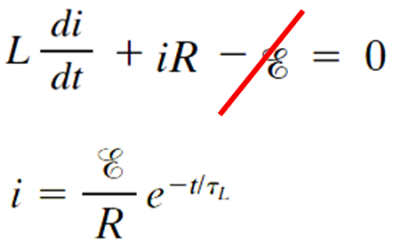
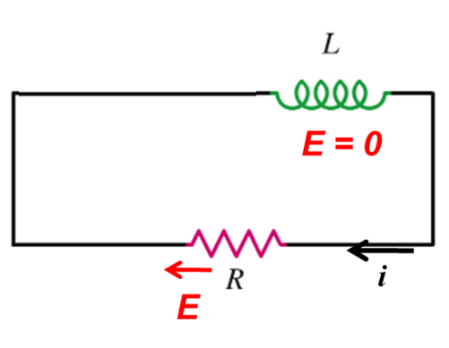
RL Circuit
At t = 0, i = 0

Slide 9
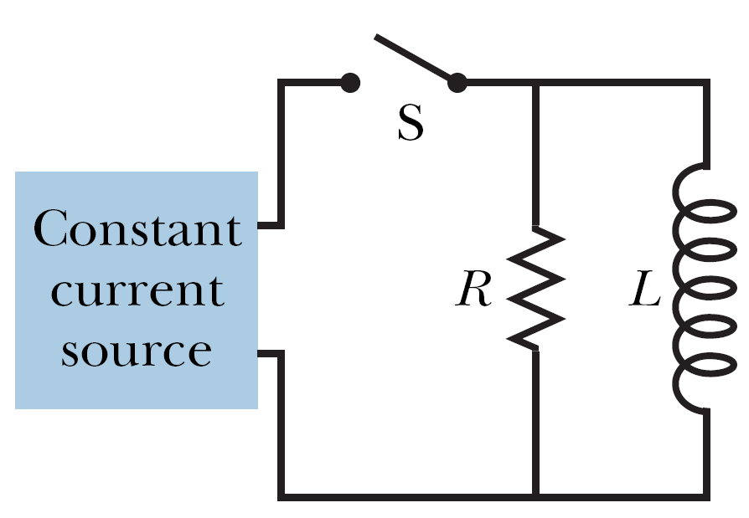
Problem 2
As shown in below figure, after switch S is closed at time t=0, the emf of the source is automatically adjusted to maintain a constant current i through S. (a) Find the current through the inductor as a function of time. (b) At what time is the current through the resistor equal to the current through the inductor?

Slide 10
Problem 2
(a) We assume i is from left to right through the closed switch. We let i₁ be the current in the resistor and take it to be downward. Let i₂ be the current in the inductor, also assumed downward. The junction rule gives i = i₁ + i₂ and the loop rule gives i₁R – L(di₂/dt) = 0. According to the junction rule, (di₁/dt) = – (di₂/dt). We substitute into the loop equation to obtain
This equation is similar to Eq. 30-44, and its solution is the function given as Eq. 30-45:
where i₀ is the current through the resistor at t = 0, just after the switch is closed. Now just after the switch is closed, the inductor prevents the rapid build-up of current in its branch, so at that moment i₂ = 0 and i₁ = i. Thus i₀ = i, so

Slide 11
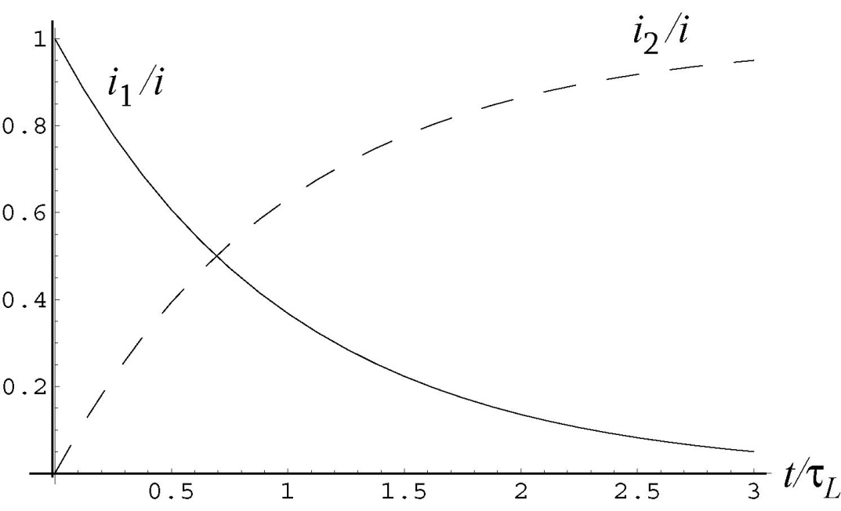
Problem 2
(b) When i₂ = i₁,
Taking the natural logarithm of both sides we obtain
A plot of as a function of is shown below.

Slide 12
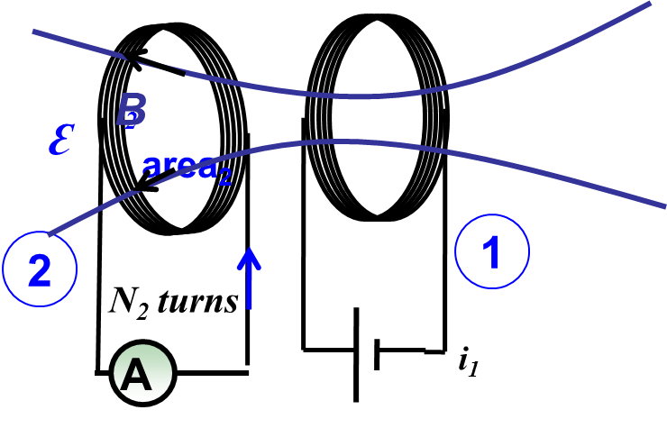


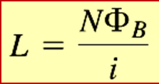
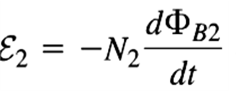
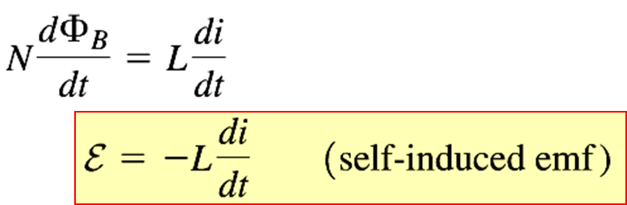


Faraday’s law & Inductance
M : Mutual inductance;
L self inductance

Slide 13
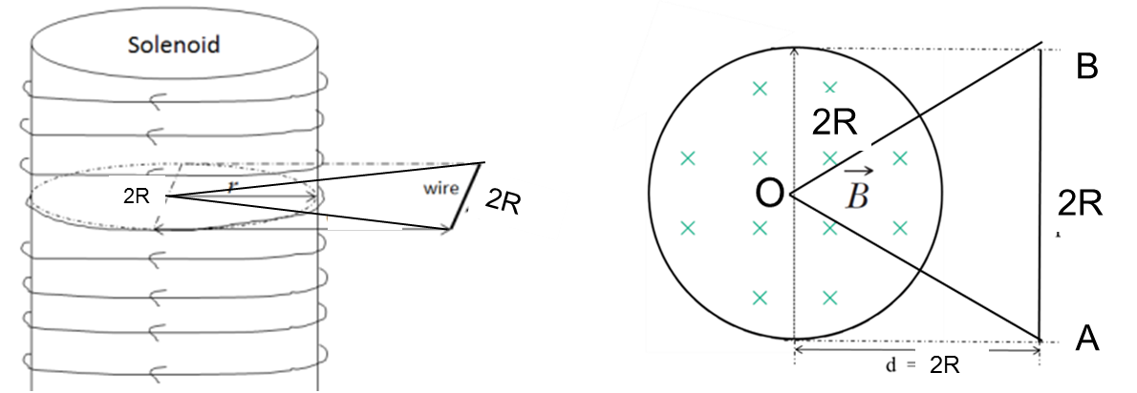
Problem 3
An ideal long solenoid has 50 turns/cm, radius R = 5 cm and length l = 52 cm. An ideal battery of ε = 10 V and resistor of R₁ = 10 Ω are in series. A triangle wire loop, whose one vertex is at the center of one coil, is put in the plane of that coil as shown in figures.
a) What is the mutual inductance for this arrangement?
b) Find the induced E(r) in the plane shown in the left figure
If the triangle wire loop is replaced by only the straight wire AB, at the same location. 5ms after the solenoid connected to the battery,
c) What is the induced emf in the straight wire AB

Slide 14
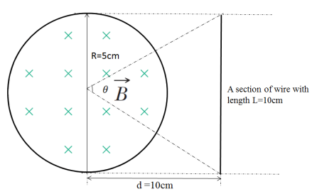

Problem 3
For RL DC circuit, the increasing current in the loop is:
$$i=\frac{ε}{R1}\text{(}1−e^{−R1t/L}\text{)}$$
The uniform B field inside the solenoid is :
$$B=μ_{0}ni$$
By using the definition of mutual inductance, we can get the mutual inductance for arrangement of the loop and solenoid:
$$A_{1}=\frac{1}{2}R^{2}θ=\frac{1}{2}{\left(5cm\right)}^{2}(0.93)=1.16×{10}^{−3}{ \text{m}}^{2}$$

Slide 15
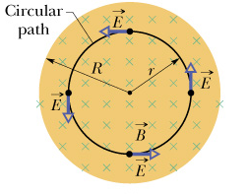



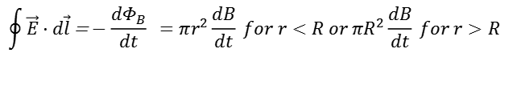

Problem 3
According to the symmetry of the B field distribution, we can imagine that the E field must also have the same symmetry. So we can choose the closed loop shown in the figure to calculate the induced electric field:
$$\begin{matrix}\oint{\vec{E}⋅d\vec{l}}\text{=}−\frac{dΦ_{B}}{dt} =πr^{2}\frac{dB}{dt} for r<R or πR^{2}\frac{dB}{dt} for r>R \\ \\ \\ \end{matrix}$$
$$\oint{\vec{E}⋅d\vec{l}}=\oint{Edscos0=E\oint{ds}=2πrE}$$
$$Ein=\frac{r}{2}\frac{dB}{dt}=\frac{r}{2}μ_{0}n\frac{di}{dt}=E0\frac{r}{R} r<R$$
$$Eout=\frac{R2}{2r}μ_{0}n\frac{di}{dt}=E0\frac{R}{r} r>R$$
$${(E0 =\frac{1}{2}Rμ}_{0}n\frac{di}{dt})$$

Slide 16
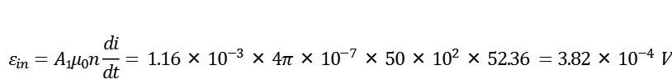
Problem 3
The self-inductance of the solenoid is:
$$L=μ_{0}n^{2}Al=4π×{10}^{−7}×{\text{(}\text{50}×{\text{10}}^{2}\text{)}}^{2}×π{\text{(}5×{10}^{−2}\text{)}}^{2}×\text{0}\text{.}\text{52}\text{m}=0.13 H$$
Method 1：
Because the induced E field has no radial component, so the induced emf in the straight wire exactly equals the induced emf in the triangle loop, so we have:
$$\frac{di}{dt}=\frac{ε}{R}\frac{R}{L}e^{−Rt/L}=\frac{ε}{L}e^{−Rt/L}=\frac{10}{0.13}e^{−\text{(}\text{10}\text{)(}\text{0}{\text{.}\text{005}\text{)}}/{0.13}}=52.36 A/s$$
$$\begin{matrix} \\ \\ ε_{in}=A1μ_{0}n\frac{di}{dt}= 1.16×{10}^{−3}×4π×{10}^{−7}×50×{10}^{2}×52.36 =3.82×{10}^{−4} \text{V} \end{matrix}$$

Slide 17



Problem 3
Method 2：
We have known the induced electric field distribution, so we do the following integral directly:
$${(E0 =\frac{1}{2}Rμ}_{0}n\frac{di}{dt}, A1=\frac{1}{2}R^{2}θ)$$

